Slide 1


2019 Economic Forecast

Slide 2
Agenda
Global & National Economic Factors
Regional Economic Factors
Local Economic Factors
Forecast for 2019

Slide 3
Global & national economy
US Government
President, Senate, and House Control
Tax cuts in 2018
Trade uncertainty - tariffs
Government shutdown
Continued uncertainty and gridlock

Slide 4
Global & National Economy
US Economy
  Decade of continued expansion
Federal Reserve
  Short term rates
Federal Funds Rate
  2019 – 2.40% Average Yield
https://www.macrotrends.net/2015/fed-funds-rate-historical-chart

Slide 5
Global & National Economy
Percent
Board of Governors of the Federal Reserve System (US), 2-Year Treasury Constant Maturity Rate [DGS2], retrieved from FRED, Federal Reserve Bank of St. Louis; https://fred.stlouisfed.org/series/DGS2, January 24, 2019.
Board of Governors of the Federal Reserve System (US), 10-Year Treasury Constant Maturity Rate [DGS10], retrieved from FRED, Federal Reserve Bank of St. Louis; https://fred.stlouisfed.org/series/DGS10, January 24, 2019

Slide 6
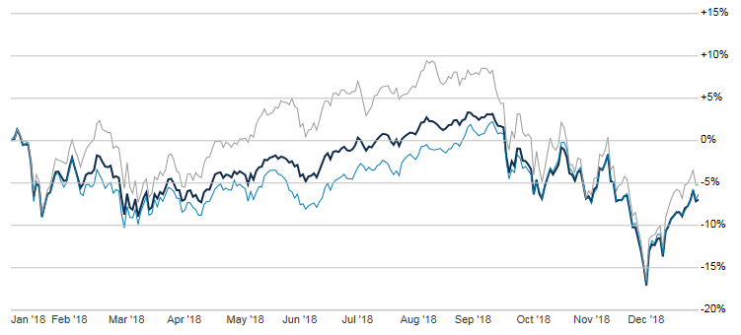
Global & National Economy
Equity Market Graph
(January 2018-January 2019)
NASDAQ
S&P 500
DOW
https://www.thestreet.com/quote/%5EGSPC.html

Slide 7
Global & National Economy
https://www.investing.com/economic-calendar/cb-consumer-confidence-48

Slide 8
Regional Economy
New Jersey State Government
Governor, Senate, and Assembly Control
Tax changes – Corporate, Individual, Gas
Not addressing the pension obligation issues
$15 Minimum Wage

Slide 9
Regional Economy
Currently $8.85 per hour
Increase $1.15 to $10 per hour in July 2019
Increase $1.00 on January 1 of each subsequent year until it reaches $15 on January 1, 2024.
Minimum Wage $15 by January 1, 2026 for seasonal workers and employees at small businesses who employ 5 workers or less
Tipped workers will go from $2.13 to $5.13 over 5 years

Slide 10
Regional Economy
Casino Revenue
Total Revenue of $2.86 billion
Up 7.50% from 2017
5,750 increase in jobs
http://www.mcall.com/news/nationworld/pennsylvania/mc-nws-atlantic-city-casino-revenue-20190114-story.html

Slide 11
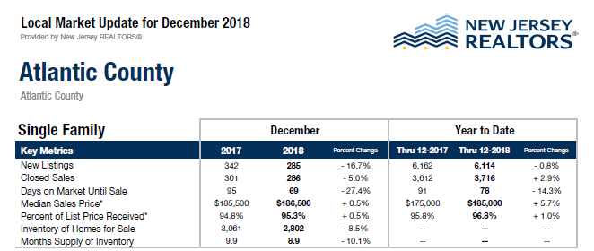
Local Economy

Slide 12
Local Economy
Ocean City Real Estate Market
Strong performance in 4th Quarter
Ocean City 2018 Quarterly Statistics YTD
 | 3/31/2018 | 6/30/2018 | 9/30/2018 | 12/30/2018
Single Family Homes Sold | 40 | 113 | 169 | 238
Single Family Homes Average Price Sold | $812,850 | $868,807 | $875,583 | $891,080
Single Family Homes Average Days on Market | 101 | 96 | 91 | 87
Condos Sold | 152 | 363 | 526 | 688
Condos Average Price Sold | $551,398 | $524,731 | $536,611 | $547,475
Condos Average Days on Market | 101 | 96 | 91 | -

Slide 13
Local Economy
Real Estate Market
Average price of sold properties continues to rise at a consistent pace, notably single family properties
New construction - Single family homes outnumbered duplex buildings 2:1
2018 Ocean City Real Estate Market Report
 | 4th Qtr. 2017 | 4th Qtr. 2018 | 2017 YTD | 2018 YTD
Total Units Sold | 325 | 363 | 1194 | 1228
Total Volume | $173 Mil | $261 Mil | $678 Mil | $802 Mil
Average Unit Price | $652K/Unit | $720K/Unit | $620K/Unit | $653K/Unit
Construction Report
 | 2016 | 2017 | 2018
Total New Buildings | 147 | 139 | 135
Single Family Units/Buildings | 91 | 72 | 88
Duplex Buildings | 52 | 61 | 45
Other (3 Units or More) | 4 | 6 | 2

Slide 14
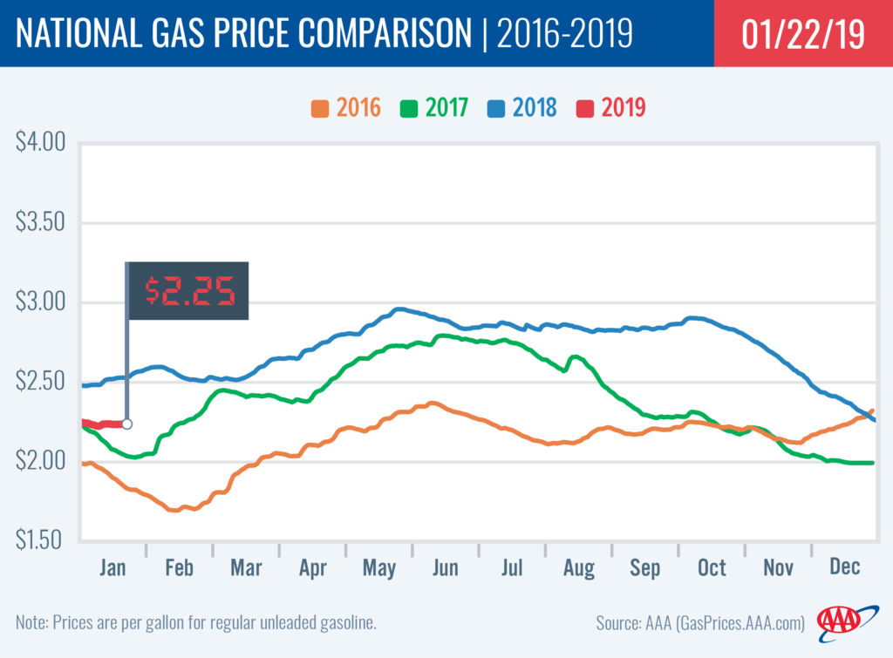
Local Economy
National Gas Prices
https://newsroom.aaa.com/2019/01/national-average-nearing-two-year-low-2/

Slide 15
Local Economy
Weather
  48 days of rainfall over 0.5 inch in 2018
  Impact of Philadelphia forecasting
  Impact on boardwalk varies from downtown
https://www.usclimatedata.com/climate/atlantic-city/new-jersey/united-states/usnj0015/2018/1

Slide 16
Forecast for 2019
US Government – Continued gridlock in Washington
US Economy expansion continues but at a slower pace – Fed on hold but will increase the funds rate one time later in the year
30 Year mortgage rates remain between 4.50%-4.75%
Stock Market – Indexes up 4%-6%
NJ Government – sales tax will increase July 1
Casinos – Revenues up 7%-8%
Property values increase slightly and sales volume remains good
Hopefully it will be a sunny and warm upcoming season for us all!

Slide 17
Thank you
Contact info:
Gregory Matuson
gmatus@sturdyonline.com

